Slide 1
DermaDetect:
Medical Image Analysis for skin conditions and rashes via Convolutional Neural Networks
Siddharth Sharma, BASIS Independent Silicon Valley

Slide 2
Agenda and Purpose
An example of a project in the past where I worked with DL and Conv. Neural Nets for Medical Imaging
This project is a more qualitative medical imaging analysis
If I were to pursue an internship, I would look for work with tumors or cancer as mammograms or MRI scans are easily available
I am looking to apply my skills in ML and DL to radiology or pathology

Slide 3
Introduction
Millions of people across the globe contract skin conditions and rashes that may irritate, clog, or inflame skin
Such diseases can also lead to redness, swelling, burning, and itching
The goal is to reduce manual efforts and the time consumption of dermatologists and patients
Lack of Quantification
Inaccurate Predictions and Treatments
Late diagnostics

Slide 4
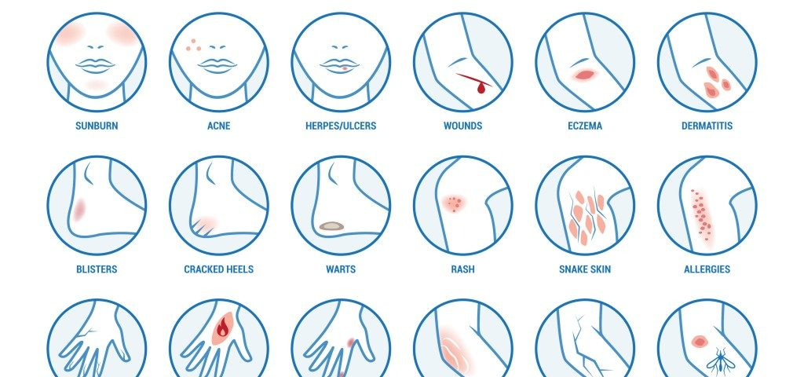
Background on Skin Conditions
Hundreds of skin conditions exist and have different symptoms and treatments (ex. Use disinfectants or water?)
Some may be contagious, a complication, or even life-threatening
If treated incorrectly or too late, skin rashes can lead to unwanted complications such as the spreading of the rash, or painful burning and irritation.

Slide 5
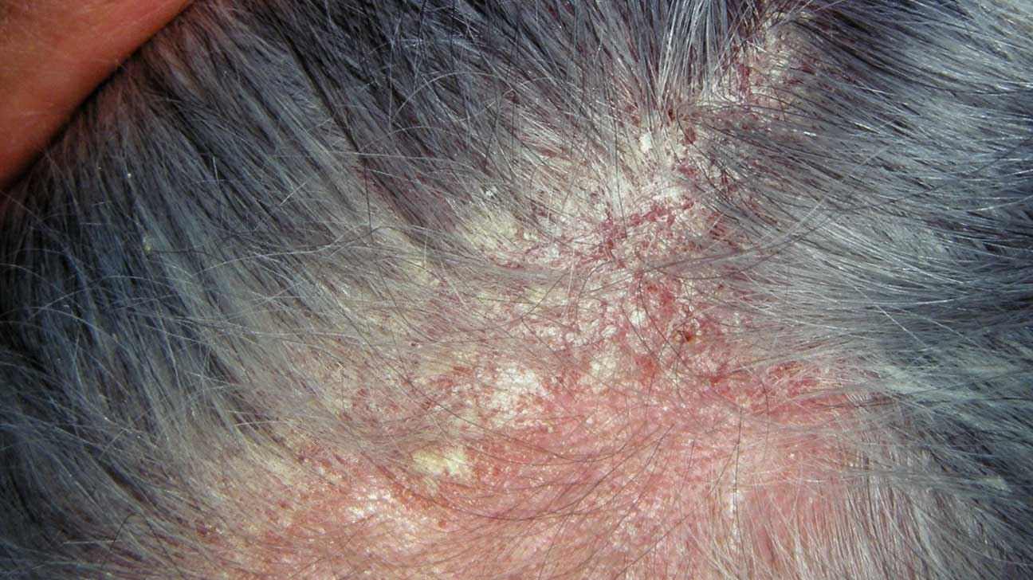
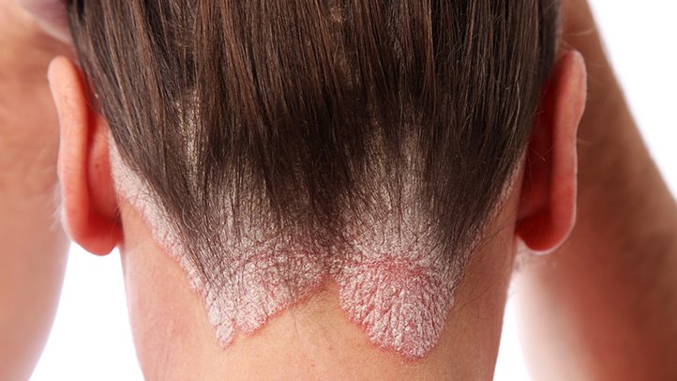
The Problem
In terms of their classification, skin conditions are difficult to classify and differentiate if the patient is not a specialist
This is due to the slight differences in the appearances of certain rashes and skin conditions
For example, two skin diseases, psoriasis and seborrheic dermatitis (seborrhea), are both very similar-looking rashes that occur to the skin, but are slightly different in that the scales of psoriasis are thicker
Seborrhea
Psoriasis

Slide 6
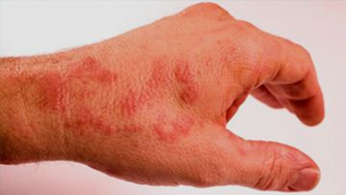
Current Solutions
The only viable solution to the problem of skin diseases is to consult a specialist or dermatologist
No diagnosis system or automated approach is currently in-use
Visits to the dermatologist may be inefficient from a time/cost standpoint
Some skin rashes and diseases must be treated immediately
Ex. Toxic Shock Syndrome (TTS) – dangerous, fatal rash
Toxic Shock Syndrome

Slide 7
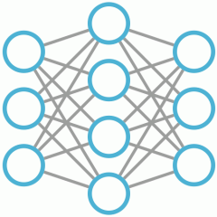
Strategy
Use image recognition to classify and diagnose certain skin conditions
Using a supervised learning model or Deep Learning algorithm to effectively classify an image input of a skin condition
The model can be used be used by individuals (such as nurses or parents) with no major medical expertise to perform an accurate diagnosis of skin conditions and rashes.
Possible future work: eventually implement model into more accessible iOS or Android application

Slide 8
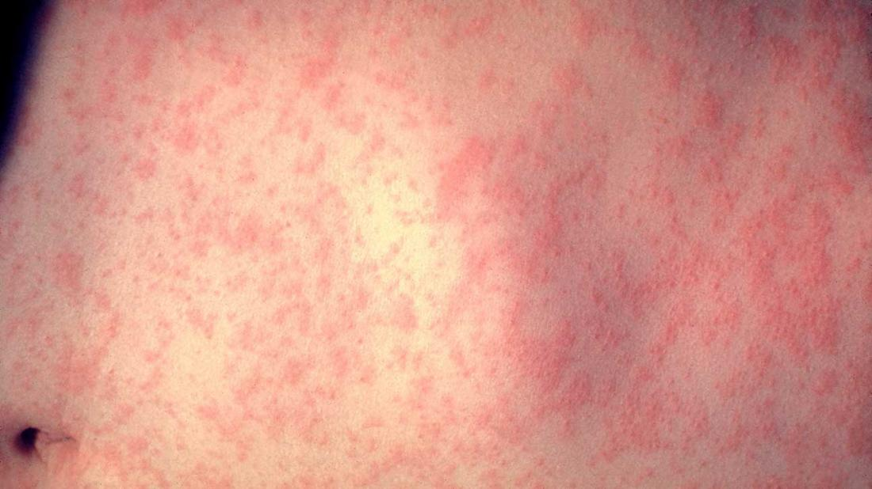
Biological Research
Researched skin rashes and conditions that were the most prevalent among individuals through websites such as WebMD, Mayo Clinic, etc.
Narrowed down to 11 skin conditions classes - chicken pox, cold sores, dermatitis, fifth disease, eczema, measles, impetigo, hives, baby acne, heat rash, and scarlet fever
The 11 skin condition classes were chosen based on prevalence of the specific rash or condition (while accounting for hybrid cases)
Subject with both Measles and Chickenpox

Slide 9
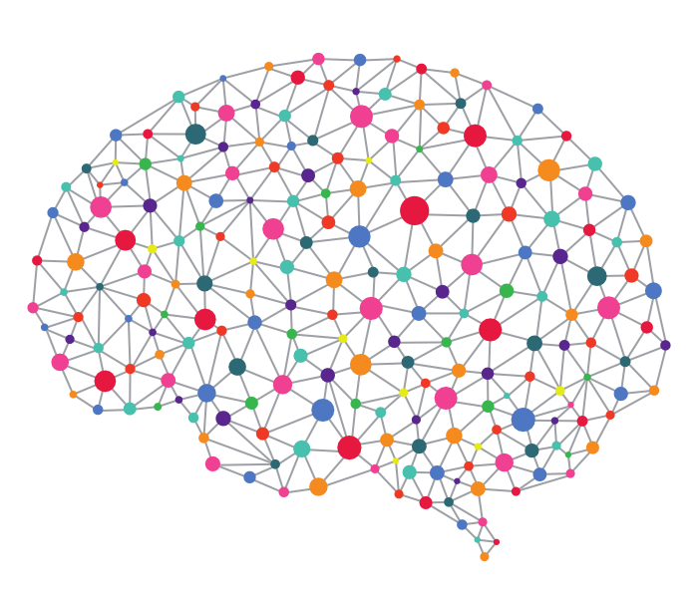
Algorithms and Comp. Sci Research
Tackling image inputs (ex. Skin conditions) requires an image classification or computer vision model
Based on previous literature and current practices in industry, it was found to be necessary to use a supervised learning algorithm which could handle a multi-classification problem
This algorithm takes images as input dataset and then classifies each image into a specific class
For the purposes of the project, a Convolutional Neural Network (ResNet) was used; the ResNet model was trained from scratch and with transfer learning.

Slide 10
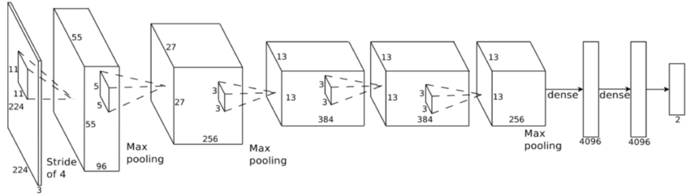
Convolutional Neural Network
Type of Deep Neural Network
Assumes that input is an image → converts that image to matrix of RGB values
Activation function is ReLU (Introduces nonlinearity!)
Uses spatial structure (special arrangement of neurons) and pooling (statistical downsampling)
AlexNet CNN layering

Slide 11
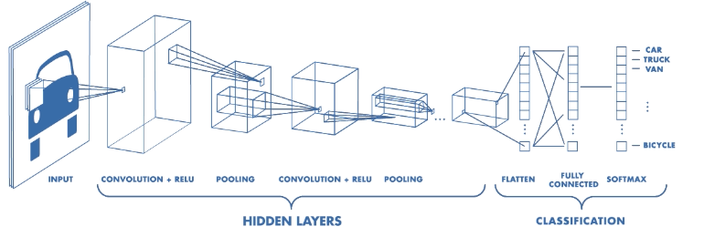

Slide 12

Google AutoML vision
Throughout the experiment, I compared the performance of my CNN model to Google’s Machine Learning Service (AutoML vision)
Google AutoML is a pay-per-use GCP API which fits a neural network for a given regression or classification problem using transfer learning
The system is relatively simple to navigate and use, as all labeling and training is automatically performed by the model
This approach represents the state of the art architectures and models currently being developed by software companies to enhance previously used Machine Learning systems
Comparison was conducted to visualize the differences between my model made from scratch and the industrial image recognition API

Slide 13
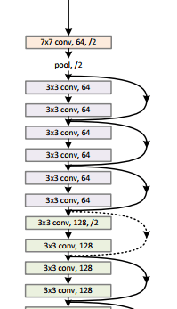
Experiment
Train CNN across original dataset to extract probability distributions and test for accuracy (precision and recall) on set of validation images
Train ResNet model through AWS Sage maker
Analyze performance on a validation (test) dataset
Through a Jupyter notebook
Compare to state-of-the-art models (Google AutoML)

Slide 14
Notes on Accuracy and Precision
The accuracy of the diagnosis for my app will be measured in terms of precision and recall
A high precision model produces fewer false positives.
A high recall model produces fewer false negatives.
Weight precision and recall side-by-side to find average precision

Slide 15
Experiment Overview
Data Labelling
Building dataset of 587 images and labeled them using AutoML vision and AWS
Model Training
Google AutoML auto-trains while AWS uses a Jupyter Notebook to train
Model analysis
Automatic analysis of the trained model in terms of precision and recall
Predictions
In order to compare precision and recall, both models perform test predictions

Slide 16
Building the dataset
Looked for existing dataset for medical images of the selected skin conditions on HPI, Kaggle – Nothing found
Reached out to Medical Institutions – ex. UCSF, Stanford Medical
Decided to create own dataset from scratch of quality images of the 11 skin conditions
In total, collected 587 “quality” images due to low availability of quality data
Quality images are defined as above a certain resolution, and portraying the specific skin condition in a large enough area , with proper lighting

Slide 17
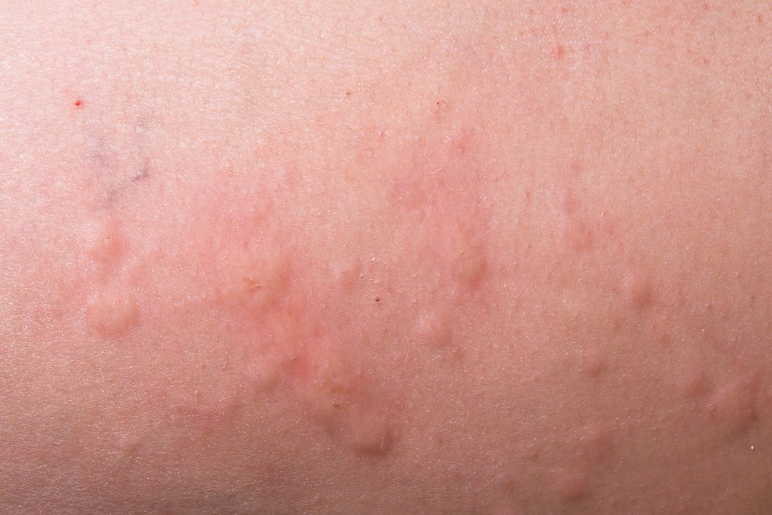
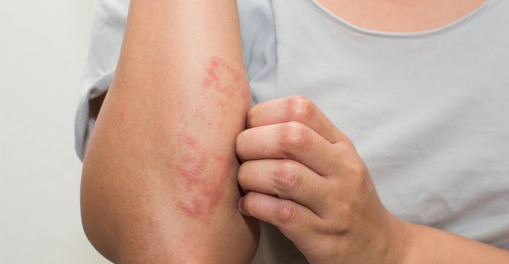
High-Quality Image
Low-Quality Image
Good lighting
Detailed portrayal
High Resolution
Bad lighting
Far portrayal (not close enough)
Lower Resolution

Slide 18
1. Data Collection, Preparation, Labeling
Collected images from various public sites and datasets for the 11 skin conditions.
Didn't use any human subjects in this experiment as many of these skin conditions are contagious.
All the images for skin conditions came from web and public digital archives with an emphasis for quality as previously mentioned
I created and labeled a dataset with 337 images of 11 skin conditions.
I used two tools to perform labeling: 1. Google AutoML, and 2. Amazon SageMaker Ground Truth, which is a data labeling tool. The labels in my dataset are the 11 skins conditions.

Slide 19
2. Model Training
I trained my model using two softwares: 1) Google AutoML Vision, and 2) AWS SageMaker.
In Google AutoML vision, the model is automatically trained for you once you have provided labeled images.
In AWS SageMaker, I created a Jupyter notebook to first analyze my input labeled dataset, and then another Jupyter notebook to train a model using the ResNet image classification algorithm.

Slide 20
3. Model Analysis and Evaluation
Google AutoML performs an automatic analysis of the trained model in terms of precision and recall. It also shows a confusion matrix.
For my ResNet model, precision and recall can be calculated via the F1 score which takes the harmonic mean of the precision and recall
The harmonic mean is a mean without extreme outliers (weighted average)

Slide 21
4. Predictions
I used Google AutoML to compare the accuracy (precision and recall) of current state of the art models to my Jupyter notebook (AWS SageMaker training) to perform predictions on a test dataset.
Such predictions return a probability distribution on whether test image matches one or more classes of skins conditions.
Each prediction provides the top five labels for each input image with the respective probabilities for each label

Slide 22
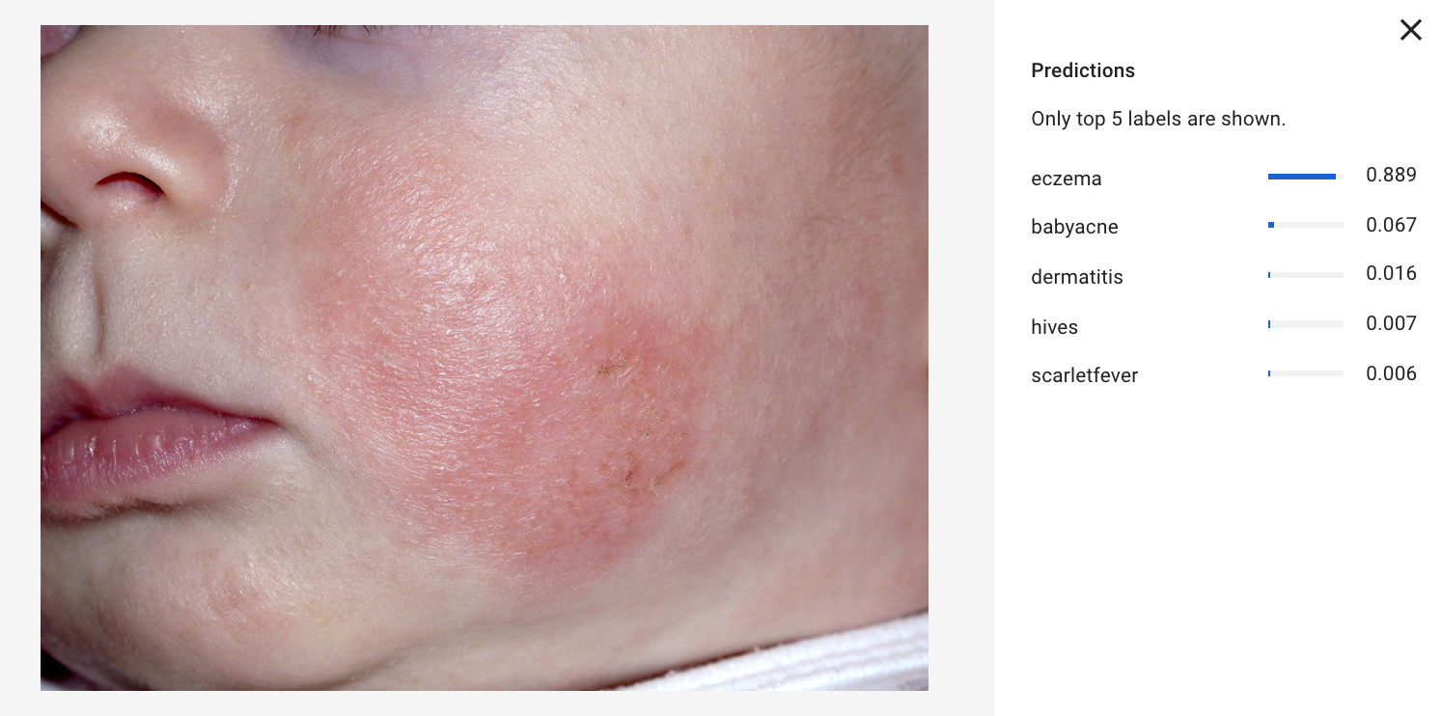
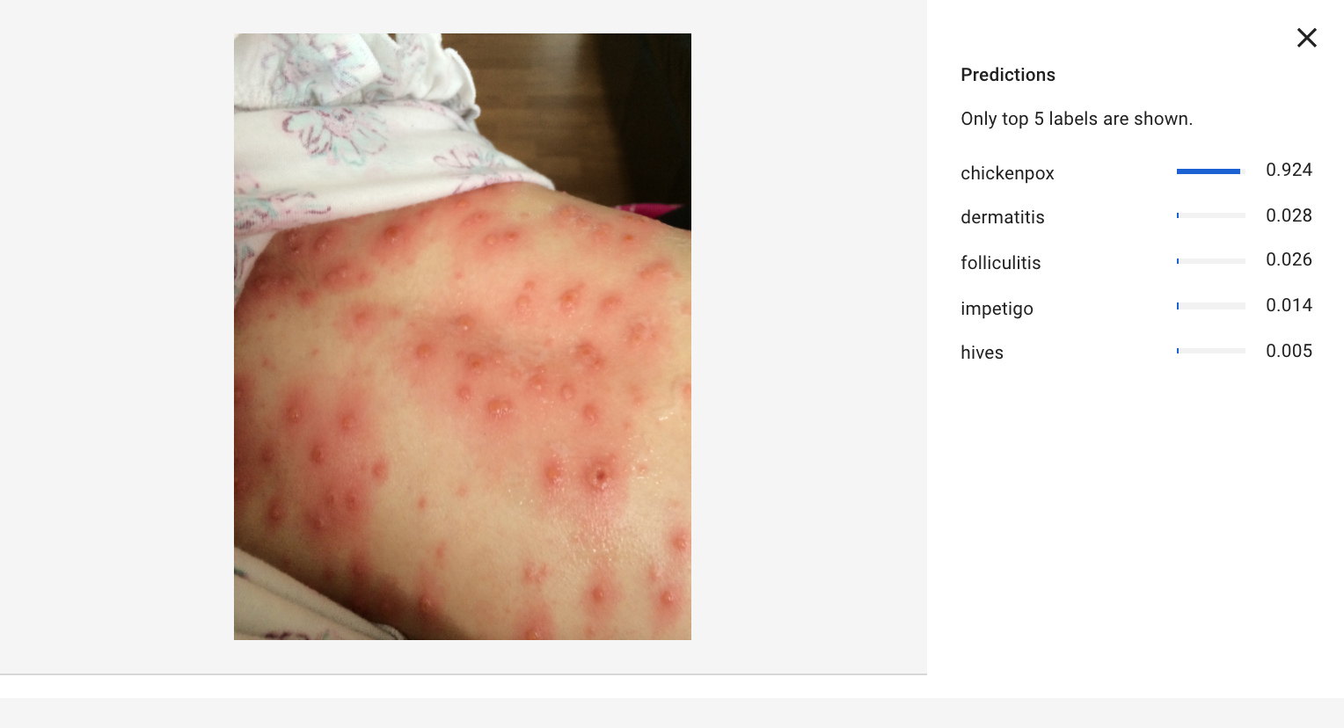
Sample Predictions

Slide 23
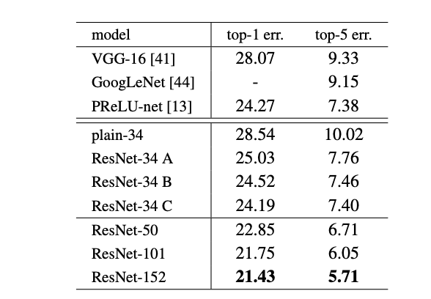
ResNet Architecture
Chose over GoogleNet, AlexNet, Keras Sequential CNN and Tensorflow API
Minimized training error
34 layer with reformulated layers (with residual functions)
Hyperparameters (post-optimization)
Epochs: 30
Learning rate: 0.1
Layers: 34 (did try 101)
Image Shape: 3, 244, 244
Classes: 11
Use of batch normalization
Reduced covariance shift and created greater independence

Slide 24
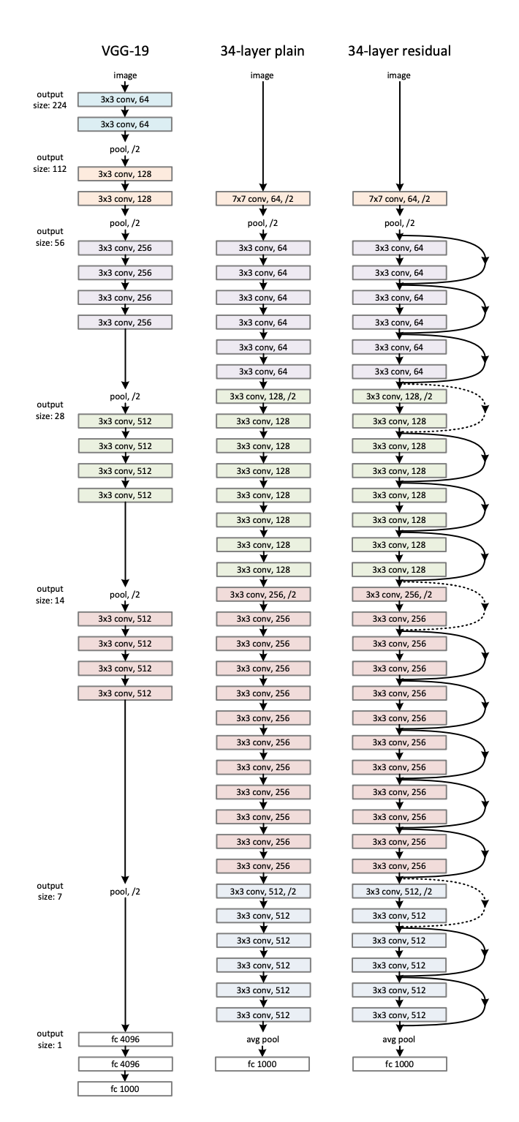
Residual Network (ResNet)
Visualization

Slide 25
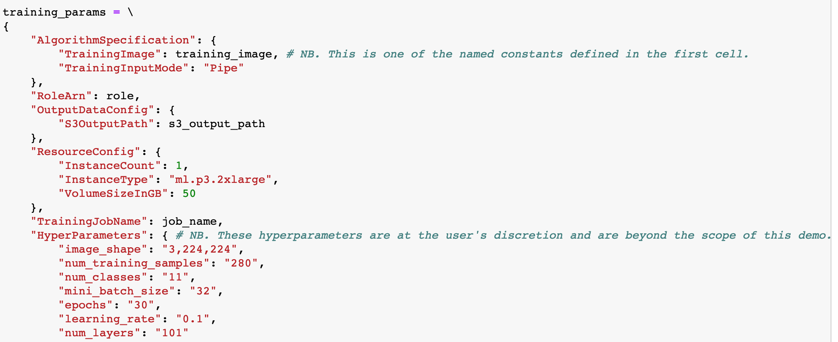
Jupyter Notebook
Used python for downloading dataset and creating training job

Slide 26
Comparison of Performances
Industrial Approach (Google AutoML)
My self-trained ResNet model
Precision: 0.898
Recall: 0.634
Avg. Precision: 0.887
Precision: 0.925
Recall: 0.681
Avg. Precision: 0.917

Slide 27
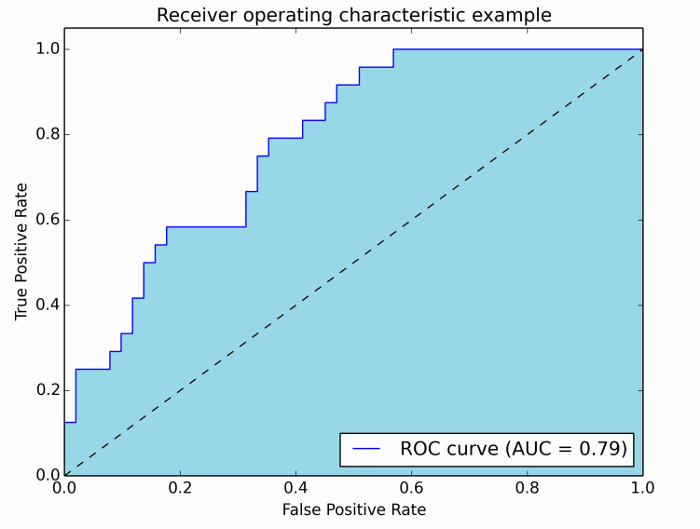
RoC AUC Curve
I had read several previous papers on an implementation of a CNN model for medical diagnosis and saw the use of a RoC curve
Receiver Operating Characteristic Curve
Similarly, I tried to generate a RoC AUC curve for my multi-classification problem but had little success
ROC AUC is usually only successful for binary classification (not 11 classes!)
Example of RoC AUC curve for binary classification

Slide 28
Discussion and Conclusion
If I was able to expand my dataset to nearly 1000 images, the precision would have reached upwards of 0.95
Based on the current resources and time available for experimentation, I was design a high precision (>0.9) computer vision model that predicts the class of skin disease that a subject has
My approach was able to outperform the state of the art-image Google Vision classification models based on quantitative metrics such as precision and recall

Slide 29
Challenges
Had a lot of trouble deciding on metric for accuracy
Initially pursued RoC then settled on precison v. recall tradeoff
Confused on which CNN to pick
Spent a few weeks researching GANNs, Keras, and other DL networks and frameworks
Low Availability of Data for my problem
Did a lot of surfing across google images, NIH, NHS, and other medical repositories
Was difficult to collect 587 images

Slide 30
Future Research
Reach out to more medical institutions and healthcare providers to obtain data without licensing or privacy issues
Ex. Kaiser, Palo Alto Medical Foundation, LabCorp
Expand current dataset to approximately 1,000 images
Implementing synthetic data into pipeline
Addressing skin color, topography, and orifices

Slide 31
Acknowledgements
Kevyn Adams of BASIS Independent Silicon Valley for being my mentor and providing guidance
Prof. Perona of Caltech for his valuable feedback

Slide 32
Internship in Stanford QIAI
Work to improve current imaging techniques
Reduce inaccurate qualitative assessment created by human imaging
Automate classification of diseases to recognize subtle features
Captured my interest due to interdisciplinary application
Connect Deep Learning and Computer Vision to Biomedical imaging
Learn practical lab skills in applying DL techniques to medical diagnosis and assessment issues

Slide 33
Specific Research Interests
Pathology – treatment of cancer
Lymphoma
Breast Cancer
Skin Cancer (Melanoma)
Lesion
Neurodegenerative diseases
Parkinson's
Alzheimer’s

